Slide 1
Continuous Monitoring

Slide 2
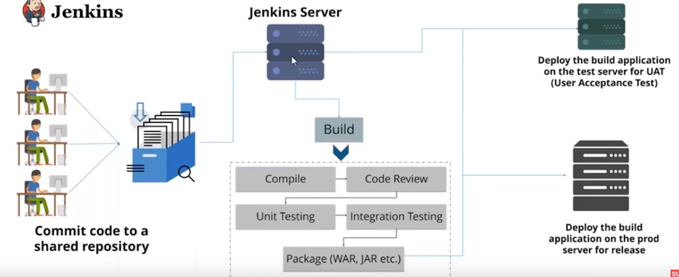
Continuous Deployment

Slide 3
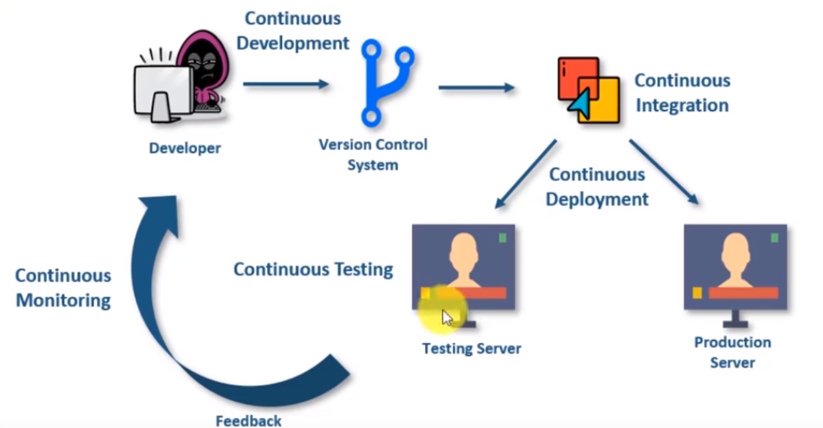
How Devops Works

Slide 4
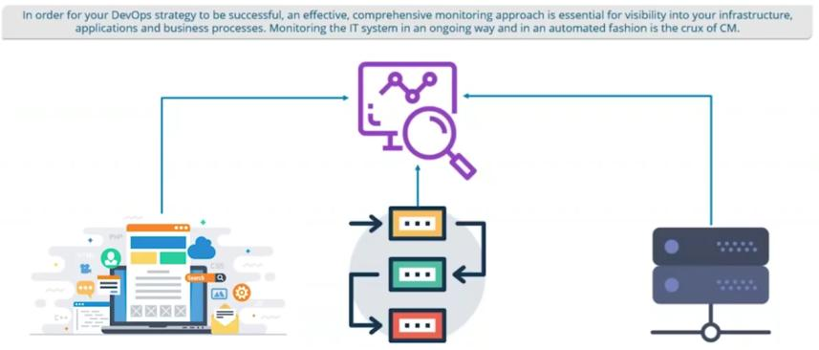
What is Continuous Monitoring ?

Slide 5
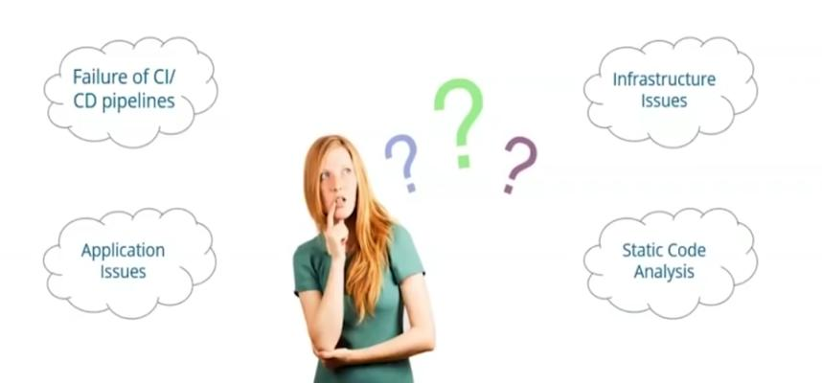
Why Continuous Monitoring

Slide 6
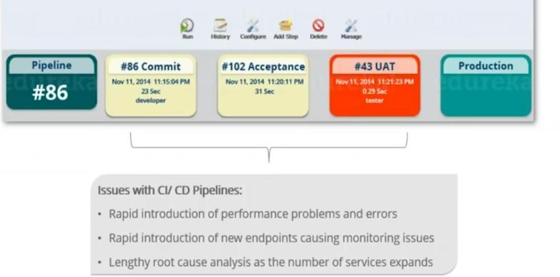
Why Continuous Monitoring

Slide 7
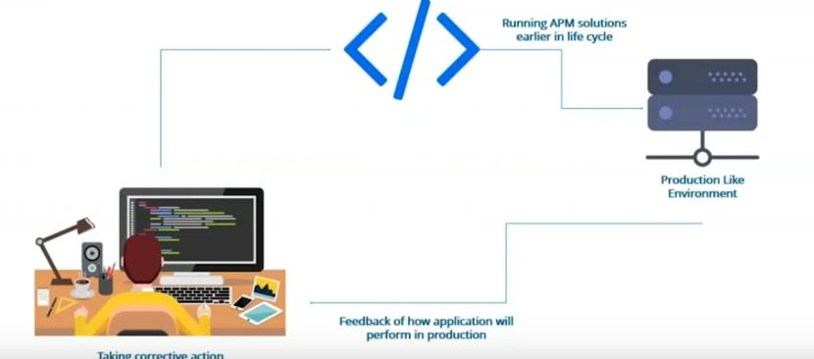
Why Continuous Monitoring

Slide 8
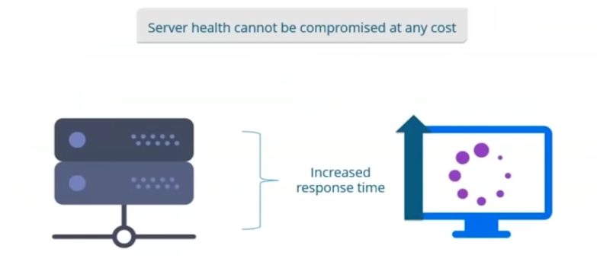
Why Continuous Monitoring

Slide 9
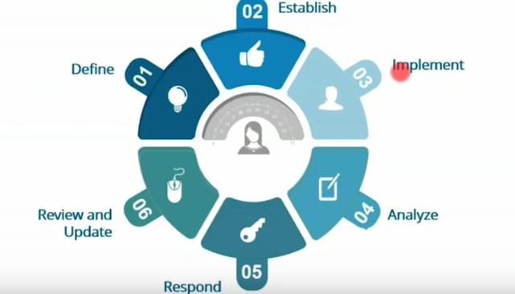
Continuous Monitoring Phases

Slide 10
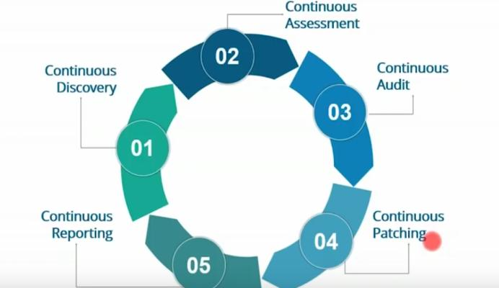
Continuous Monitoring Phases

Slide 11

Continuous Monitoring Tools

Slide 12
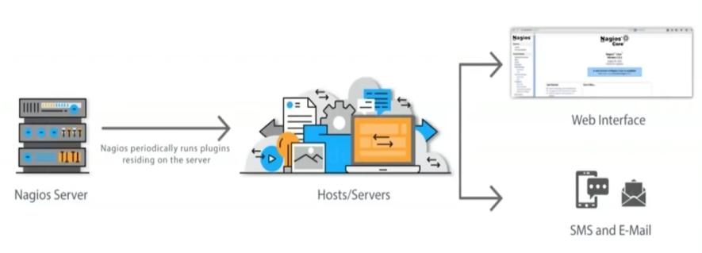
Nagios Architecture

Slide 13
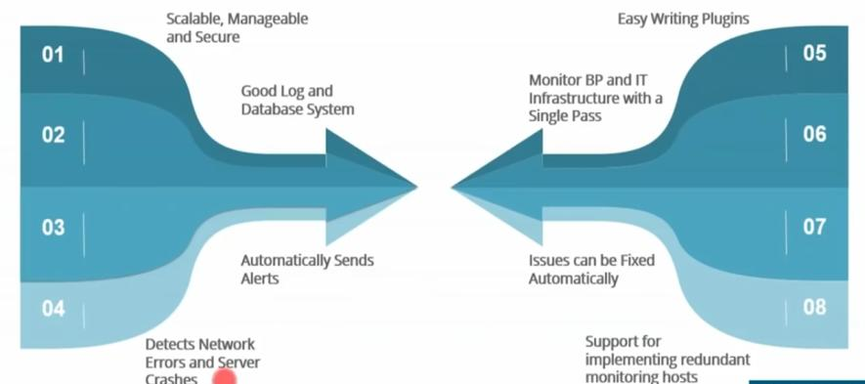
Nagios Features

Slide 14
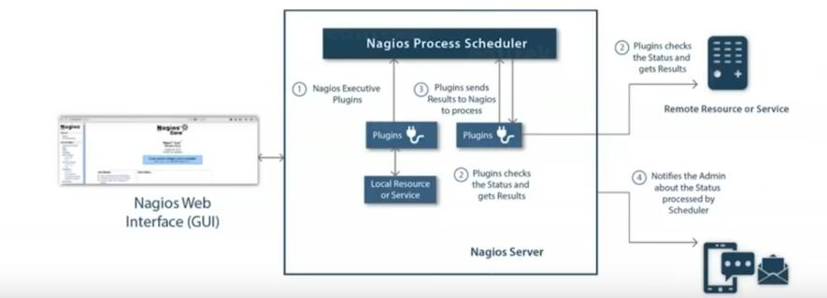
Nagios Architecture

Slide 15
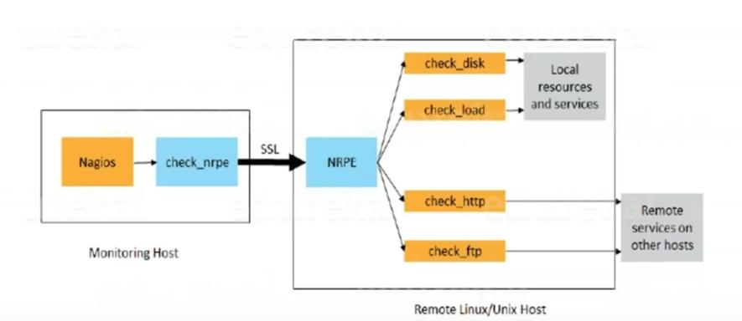
Nagios Monitoring Remote Hosts

Slide 16
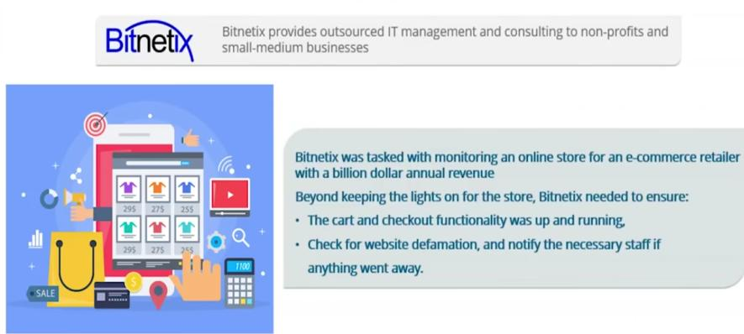
Nagios Case Study

